Slide 1
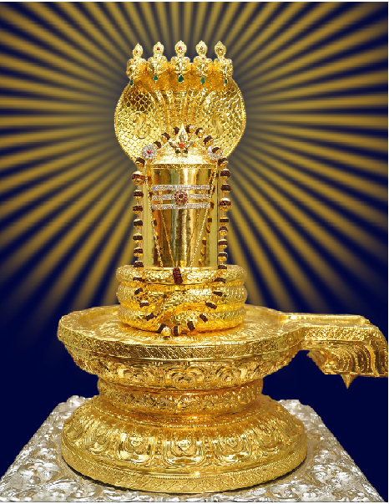
Sahasra Lingarchana 16 Avaranas Details

Slide 2
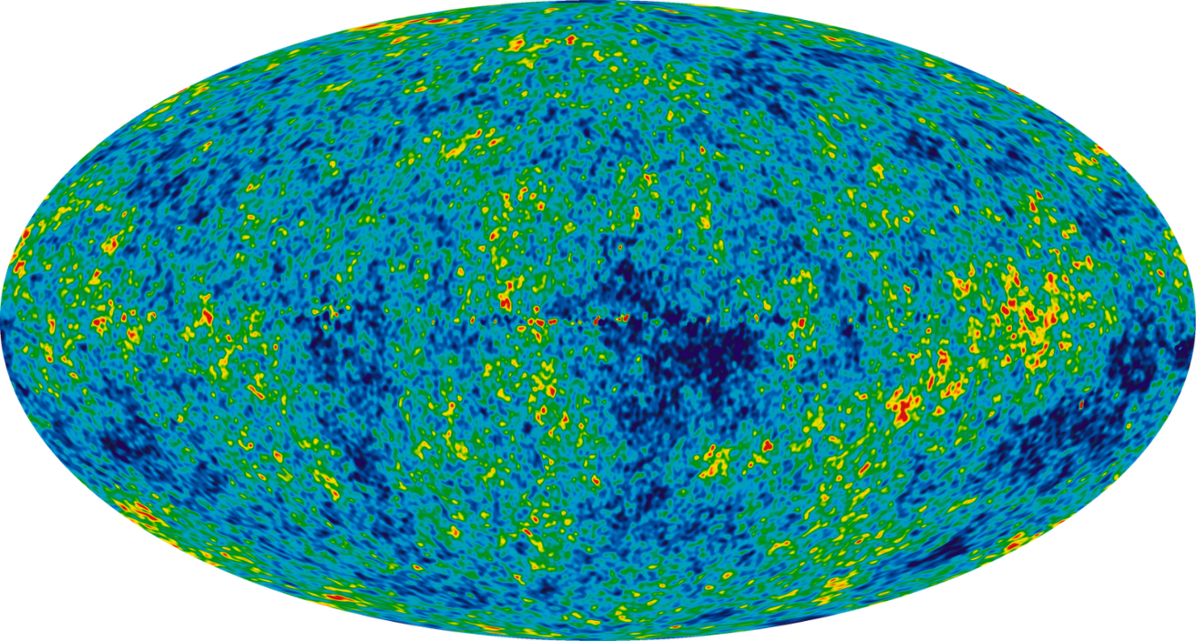
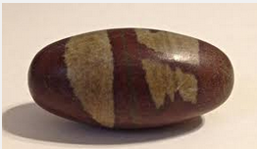
Known universe shape as Bana Lingam
Universe
Bana Lingam

Slide 3
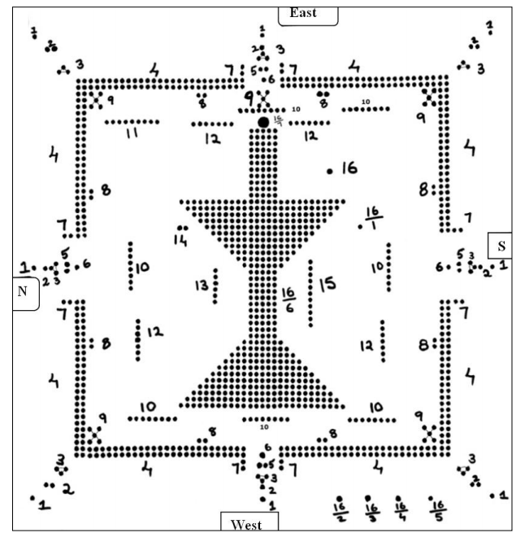
Kailasa Prastharam

Slide 4
1.Pradhama Avaranam
Ashta Dikpalakas
Start from east
Clockwise direction
1 at each direction

Slide 5
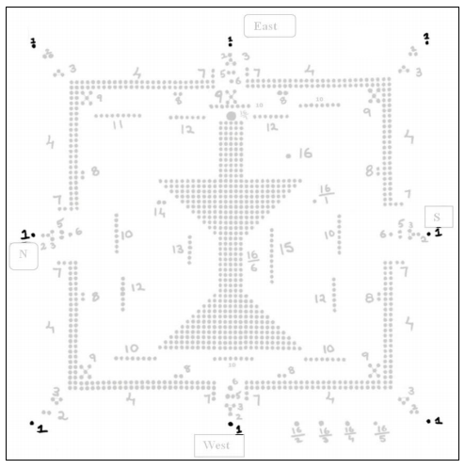
1. Pradhama Avaranam

Slide 6
2.Dwiteeya Avaranam
Dwadasa Aditya
Start from East
Clockwise direction
1 at each direction and
2 at each Corner

Slide 7
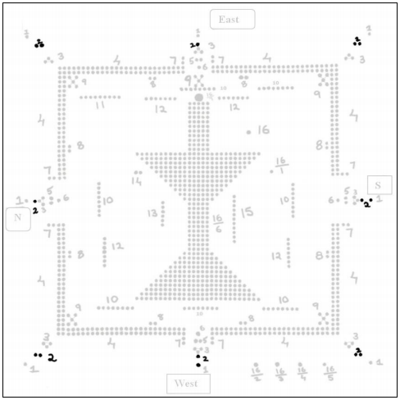
2. Dwiteeya Avaranam

Slide 8
3.Truteeya Avaranam
Trishulas (24 Lingas)
Start from East
clockwise direction
3 at Each direction

Slide 9
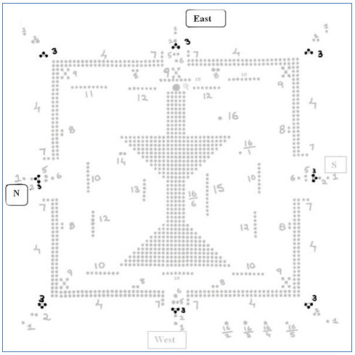
3. Truteeya Avaranam

Slide 10
4.Chaturdha Avaranam
Tandameshwara (400 Lingas)
Start from East
clockwise direction

Slide 11
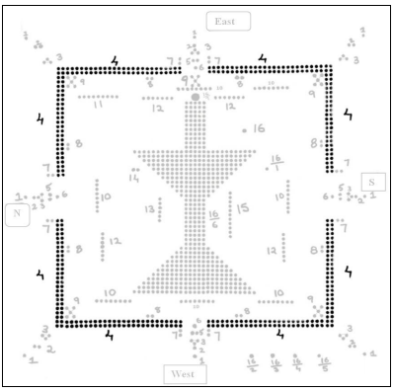
4. Chaturdha Avaranam

Slide 12
5.Panchama Avaranam
Ashta Bhetala (8 Lingas)
Start from East
clockwise direction
2 at all directions

Slide 13
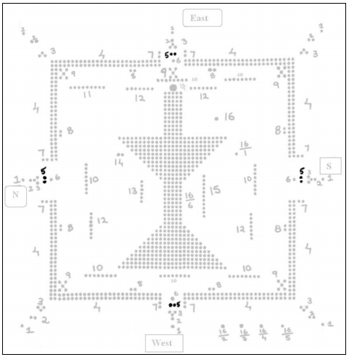
5. Panchama Avaranam

Slide 14
6.Shashtama Avaranam
Chaturvedas (4 Lingas)
Start from East
clockwise direction
1 at all directions

Slide 15
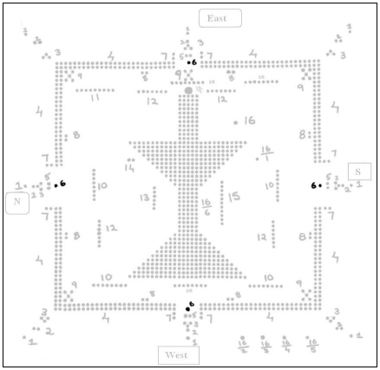
6.Shashtama Avaranam

Slide 16
7.Saptama Avaranam
Shodasa Dwarapalakas
(16 Lingas)
Start from north-east of the entrance in clockwise direction

Slide 17
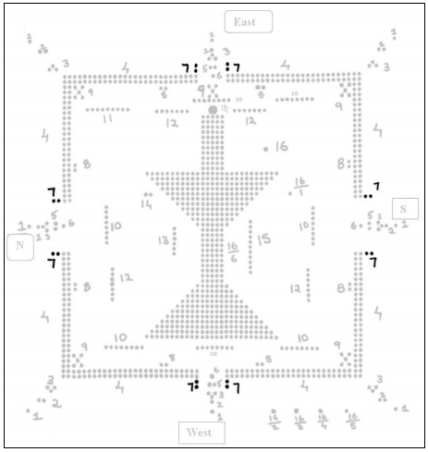
7.Saptama Avaranam

Slide 18
8.Ashtama Avaranam
Patni Sameta Ashtamurthi
(16 Lingas)
Start from north-east clockwise direction

Slide 19
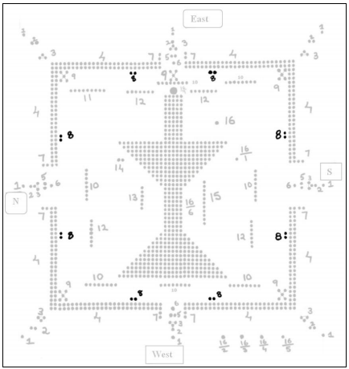
8.Ashtama Avaranam

Slide 20
9.Navama Avaranam
Pancha Brahmas(25 Lingas)
Start from north-east in clockwise direction

Slide 21
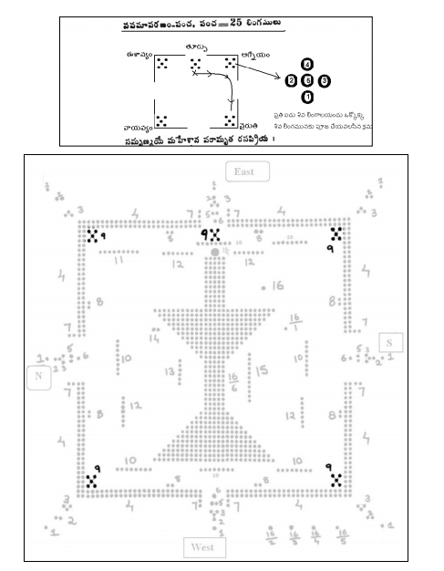
9.Navama Avaranam

Slide 22
10.Dasama Avaranam
Sapta Dikshu Ashta Ashta Vasoon (7 X 8 = 56 Lingas)
Start from east clockwise direction

Slide 23
10. Dasama Varanam
Ashta Ganapathyah (8 Lingas)
Start from east in clockwise direction
(Please follow arrows for the direction of worship)

Slide 24
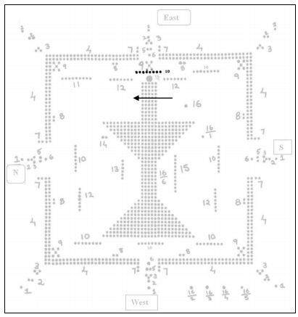
10-1. Ashta Ganapatyaha

Slide 25
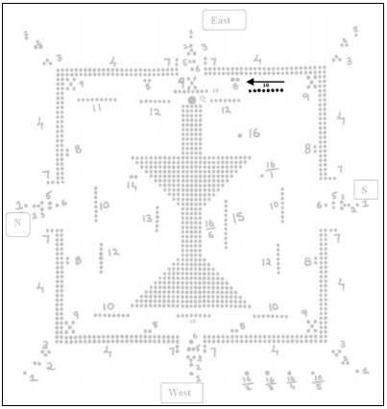
10-2.Naagaashtaka Vasuhu

Slide 26
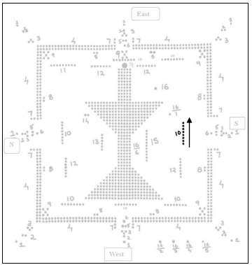
10-3. Yaamyashtaya Siddhayaha

Slide 27
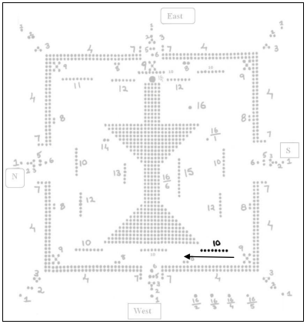
10-4. Shakti Vasavaha

Slide 28
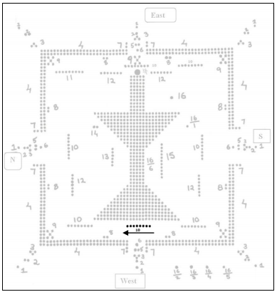
10-5. Ashta Maatrukaa Vasavaha

Slide 29
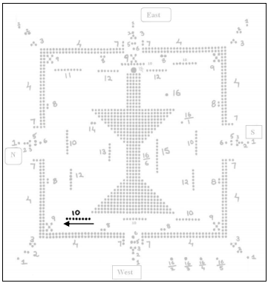
10-6. Ashta Vasavaha

Slide 30
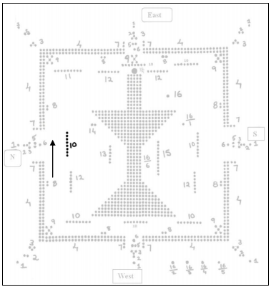
10-7. Ashta Bhairava Vasavah

Slide 31
11.Ekaadasa Avaranam
Nava Grahaha (9 Lingas)
Located at north east corner.
Pls note the direction of worship.

Slide 32
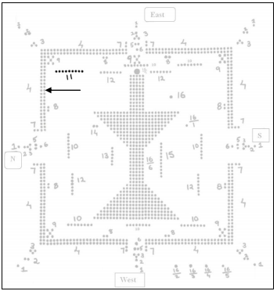
11.NavaGrahah

Slide 33
12.Dwadasa Varanam
Parvatebhyoh , Nadibhyoh , Rushibhyoh , Saagarebhyoh(4 X 7 = 49 Lingas)
Pls not the direction of worship.(next slide)

Slide 34
12.1. Parvatebhyoh
Parvatebhyoh(7 Lingas)
Pls not the direction of worship.(next slide)

Slide 35
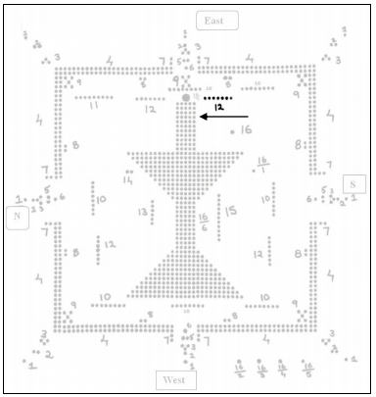
12.1. Parvatebhyoh

Slide 36
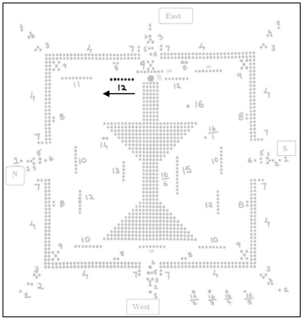
12.2. Nadibhyoh

Slide 37
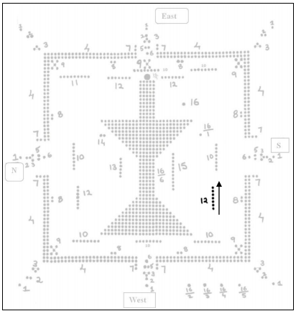
12.3. Rushibhyoh

Slide 38
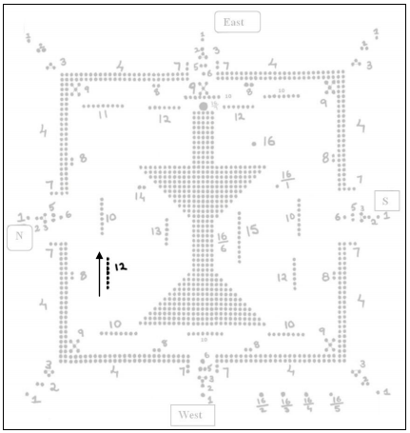
12.4. Saagarebhyoh

Slide 39
13.Trayodasa Varanam
Shat-taaraka Lingah (6 LINGA)
Pls note the direction to worship.

Slide 40
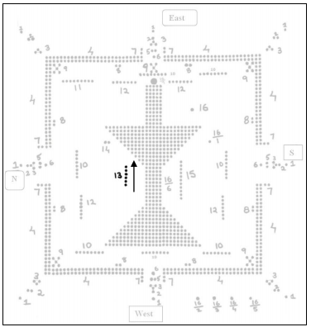
13. Shat taaraka lingah

Slide 41
14.Chaturdhaa Varanam
Ganga-Paarwati (dwaoLingah)
Pls note the direction to worship.

Slide 42
14.Chaturdhaa Varanam

Slide 43
15. Pamchadasaa varanam
Ekaadasa Rudra Lingah (11 LINGA)
Pls note the direction to worship.

Slide 44
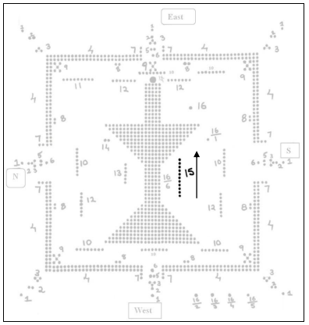
15.Panchadasa Varanam

Slide 45
16. Shodasa varanam
16.Dakshinaa Murthy (1 LINGA)
1.Chandeeswara (1 LINGA)
2.Chitra (1 LINGA)
3.Chitraguptha (1 LINGA)
4.Yama (1 LINGA)
5.Ganapathi (1 LINGA)
6. Maha Linga (484 LINGA)
6.Mukute Chandra Kala (1 LINGA)

Slide 46
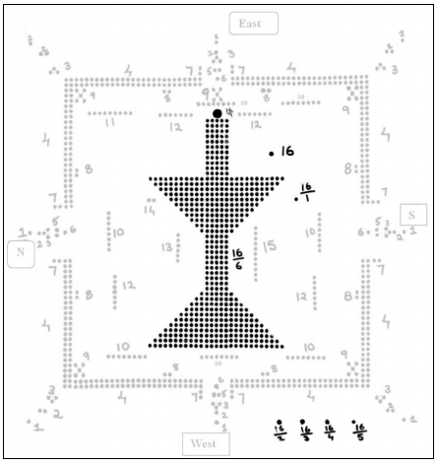
16.Shodasa Varanam

